Slide 1
Clinical Supervision
Clinical Supervision Training
April 24-25, 2021
Sheila Babendir, EdD, LPC

Slide 2
Review
Defining supervision
Roles
Responsibilities
Models
Methods

Slide 3
Defining Clinical Supervision
Bernard and Goodyear (1998) offer this definition that has come to be accepted within the counseling profession:
“Supervision is an intervention that is provided by a senior member of a profession to a junior member or members of that same profession. This relationship is evaluative, extends over time, and has the simultaneous purposes of enhancing the professional functioning of the junior member(s), monitoring the quality of professional services offered to the clients she, he, or they see(s), and serving as a gatekeeper of those who are to enter the particular profession.”

Slide 4
Defining Clinical Supervision
Borders & Brown (2005) define supervision an educational process
“Supervisors think of their supervisees as learners and they focus on creating an appropriate learning environment to help supervisees be more effective with clients and develop and mature into the profession of counseling”

Slide 5
Defining Clinical Supervision
Powell & Brodsky (2004) states that:
“Clinical supervision is a disciplined, tutorial process wherein principles are transformed into practical skills, with four overlapping foci: administrative, evaluative, clinical and supportive.”

Slide 6
Supervisor Roles
Educator
Consultant
Mentor
Counselor
Evaluator
Gatekeeper
Fellow professional

Slide 7
Supervisor have responsibilities to….
Supervisee
Supervisee’s clients
Agency/workplace
Licensure Board
The Counseling profession

Slide 8
The Supervisory Relationship
It’s complicated
Variety of roles, some of which seem contradictory: professional colleague, evaluator, gate keeper, counselor, support
Variety of focus areas: personal growth and self-awareness, professional skill development and behaviors
Changes over time – flexibility, renegotiation, back and forth

Slide 9
Supervisor as Educator
Supervision is “an intentional educational intervention”
Creating a learning environment that matches the needs of the supervisee
Purposeful and intentional
Goal-directed
Proactive
Flexible
(Borders & Brown, 2005)
Notes:
The expectation is for the supervisor to be able to teach the supervisee. This relationship is about transfer of knowledge and skills.

Slide 10
Supervisor as evaluator
Bernard and Goodyear state “…. This relationship is evaluative… monitoring the quality of professional services offered to the clients …. serving as a gatekeeper”
The need to evaluate
The need to monitor quality
Act as a gatekeeper
Notes:
The feeling is there of power differential and a clear hierarchy within this relationship.

Slide 11
The Supervisory Relationship and the Therapeutic Relationship
Parallel dynamics – vulnerability and trust, risk of disclosure and responsibility to create a safe environment
Parallel processes – the need for flexibility over time and across situations, the balance of support and challenge, the possibility of resistance
A good working alliance is essential: clear communication of expectations and boundaries
Unlike counseling, supervision is evaluative
Notes:
To serve as both an educator, an evaluator and a mentor there is a unique relationship. Often it is similar to the relationship we build with clients in therapy. As a supervisor we have to create a safe environment so our supervisees can risk disclosing their fears, mistakes, lack of skill or knowledge and be vulnerable with us. We have to be able to create a safety net and security for them to know that we provide them the support they need while still pushing and challenging to enhance their growth. We need to recognize when we are encountering resistance just as we get from clients.
We need to have clear communication, know what to expect from them and what they should expect from us and the process. They need to know the professional boundaries. What we model in our boundaries they can use with clients as well. Things are very similar however, in therapy we aren’t acting as a gatekeeper and giving a final “pass through the professional gates”

Slide 12
What do the Experts think?
Kemer, Borders & Willse, 2014. Cognitions of expert supervisors in academe: a concept mapping approach. Counselor Education and Supervision, 53, 2-18.
Invited 44 Expert Supervisors: “One specific thing I think about in planning for, conducting, and evaluating my supervision sessions is__________________?”

Slide 13
What do the Experts think?
479 statements distilled to 195.
Participants individually sorted and organized the statements – ending up with 25 clusters which were further grouped under five categories:
Conceptualization of Supervision and Intervening
Assessment of the Supervisee and his/her work
Supervisory Relationship
Supervisor Self-Assessment and Reflection
Administration and Logistics of Supervision

Slide 14
Conceptualization of Supervision and Intervening
Goal setting, agenda setting
Intervention planning, integrated with in-the-moment reality of the session
Intentional decision making
Attention to the supervisee’s development and when/where/how they need to be nudged along

Slide 15
Assessment of the Supervisee and His/Her Work
Supervisee professional growth within self:
Supervisee’s cognitive and emotional abilities, professionalism, developmental level, appropriateness and needs
Supervisee growth within the organization:
Supervisee’s functioning within the system of their site, relationship to clients, conceptual skills and reflective process

Slide 16
Supervisory Relationship
Supervisor’s professional responsibilities with regards to evaluation of supervisee
Supervisee’s response to feedback
Collaboration between the two for supervisee improvement
Supervisor’s personal experience of the relationship: emotional responses, thoughts, cultural difference considerations
Supervisee’s perception of the relationship
Supervisee’s readiness to be out of his or her comfort zone
Notes:
One of the important areas the experts identified was in regard to the evaluative piece and the response to this. In a bit we’ll talk about feedback and look at response to giving and receiving feedback more in depth.

Slide 17
Supervisor Self-Assessment and Reflection
“How am I doing with this supervisee?”
How can I do better?
What do I need to do/change to do better?
What’s happening inside when I interact with this supervisee?
Notes:
These self-assessment questions are critical but also change as supervisors go from being novice to expert as supervisors. We will look more closely at that difference a little later.

Slide 18
Administration and Logistics of Supervision
The necessities of supervision process
Knowledge of the supervisee’s site
Future planning of supervision goals

Slide 19
Reviewing the supervisee needs

Slide 20
Supervisee Developmental Level
Beginning level counselors
Need supervisor in the teacher role
Present with list of ‘how to’ questions
Need skill based and detail oriented supervision
Present with high levels of anxiety – need encouragement and support
Common supervision activities include demonstrating, role-playing, explaining, providing resources

Slide 21
Supervisee Developmental Level
Middle level counselors
Are able to access resources and are more self-directed
Supervisor becomes more facilitative
Teaching role becomes more fine-tuning clinical work versus broader ‘how to’ (e.g., modifying a technique for a particular client)
May thoughtfully/reflectively disagree with you
Counseling skills needed for IPR, metaphor, reflection, confrontation and immediacy

Slide 22
Supervisee Developmental Level
Later level counselors
Can identify his/her needs
Supervisor in role of consultant
Supervision interactions more collegial/peer-like
Greater focus un subtle and sophisticated issues (e.g., impasse, internal reaction to a particular client)
Focus on supervisee evolving professional identity

Slide 23
Supervisee Learning Goals
Concrete goals should be reviewed and discussed in-depth in initial session(s)
Supervisee must be able to identify specific questions about a particular client or session (i.e., how does this relate to their learning goals)
Supervision interventions are selected to support work on learning goals/questions for this client/session
Make connection to learning goals explicit
Notes:
How a supervisor approaches these learning goals and the needs of the supervisee at any given level depends on the model of supervision that is being used. Last weekend you learned about the basics of the developmental models, Bernards discrimination model and the adaptive supervision in counselor training model. All three of these are major theoretical models of supervision. Just as counseling modalities have changed and morphed over the decades from the basic theories to newer models, so has supervision. Today I will go over some of the more recent models of supervision.

Slide 24
IPDSM-integrative psychological developmental supervision model
Why this model?
Designed to support psychological development of the supervisee
Higher levels of psychological development results in:
Better delivery of higher level counseling skills and techniques
Develop better ability to read client needs and be flexible in strategies and interventions
Notes:
Why is this model different? Because it is looking more primarily at the psychological development of supervisee rather than technical and skills development.

Slide 25
IPDSM in theory
Grounded in Loevinger’s ego developmental theory
Challenges cognitive schema, causes discomfort and forces new perceptions/assumptions/beliefs, causing growth
Designed to enhance problem-solving skills, creativity, emotional awareness, and supervisees' confidence and self-efficacy
Notes:
grounded in Loevinger's (1976) ego developmental theory, Loevinger's model was selected because of its empirical foundation and support, its comprehensiveness, and its relationship to desired counselor qualities. ego development incorporates cognitive, moral, self, interpersonal, and character development. The ego develops toward progressively more complex levels of meaning making, impulse control, interpersonal relations, mastery, and integration
goal ofthe IPDSM is to ensure that the supervision environment first matches and then challenges students' existing cognitive schema, promoting disequilibrium, fostering an accommodative response, and leading to psychological growth

Slide 26
IPDSM (Sias and Lambie, 2008)
Begin with a check in of how supervisee is feeling
Adapt activities to match supervisee concerns
Engage at the cognitive level and the affective level
Focus on process to force new perspective taking
Reflection of supervisee experience in sessions—emphasize self-examination of assumptions, interactions and operating premises
Balance between support and challenge for growth
Supervision consistency for first year
Notes:
supervisors may begin supervision by "checking in" with supervisees about their current feelings, then adapting supervision activities to supervisees' pertinent concerns.
Supervision requires both cognitive and aifective engagement to support supervisees' psychological development
Supervision incorporates multiple role and relationships. Focusing on process rather than content alone provides an opportunity for perspective taking and relationship building
Reflection is fundamental to psychological maturation: "An emphasis on reconstructing professional experiences is central to Mezirow's (1994) belief that meaningful learning occurs only through self-examination of assumptions, patterns of interactions, and the operating premises of action , supervisors support continuous guided reflection on new experiences through group discussions in a safe and trusting environment
, clinical supervision that provides a balance between role taking and reflection must continue for 6 months to 1 year or longer
Balancing the need for support and challenge is primary
supervisors need to continually assess supervisees' needs for support, structure, and challenge and adjust the supervisory environment accordingly

Slide 27
Post Modern supervision models
Focuses on strengths rather than problems
Focuses on meaning and individual viewpoints
Considers the changing dynamic within language and interactions and the effect on reality and truth
Sees reality and truth through the eyes of the supervisee (who sees this through the eyes of the client)
Social construction based on life experiences
Notes:
Postmodern counseling approaches such as solution-focused therapy have shifted the attention away from problems. These strengths based methods are now also applied in supervision
There is a focus on meaning-making at the individual level with the assumption that their culture is made up of an infinite variety of equally valid viewpoints of the world.
Postmodernists contend that reality and truth cannot be measured empirically because they are constantly changing entities constructed by each individual through his/her language and interactions. In addition, postmodernists reason that no individual’s perspective is any more truthful than another’s, as both are accurate social constructions based on life experiences.
HOW DOES THIS DIFFER FROM PREVIOUS MODELS?

Slide 28
Themes of postmodern supervision
Increased focus on language in supervision
Value of strength-based approaches
Removing the hierarchy in the supervisory relationship
Notes:
Specifically, three themes seem to emerge when examining postmodern supervision approaches. First, there is an increased focus of the importance of language in supervision, a central tenet of the postmodern paradigm (Presbury, Echterling, & McKee, 1999). Second, the value of using strength-based approaches over deficit-based techniques (i.e., highlighting and correcting mistakes) in supervision is receiving more attention (Bernard & Goodyear, 2014). This reinforces the postmodern notion that no one perspective is “correct.” Finally, more and more authors are arguing for the removal of hierarchy within the supervision relationship
DIDN”T WE JUST TALK ABOUT THAT THERE IS A HIERARCHY BECAUSE OF THE EVALUATION AND THE GATEKEEPER ROLE???? How would this look if we are still having to have all of the responsibilities as a supervisor and the evaluative piece but focus on our language, keep it strength-based, look less at deficits and not have the obvious hierarchy?

Slide 29
What is the benefit?
Create an environment that promotes supervisees to gain more clinical insight
Increase their internal motivation to take ownership of their growth and acquisition of knowledge
Still have to balance and always address harmful therapeutic ignorance
Notes:
Supervisors must consistently balance the need to directly address potentially harmful levels of therapeutic ignorance with the great benefits of permitting supervisees to engineer their own clinical insights – thereby increasing the likelihood that they will take ownership of, and retain, their acquired knowledge

Slide 30
Narrative supervision
Like narrative therapy
Focus on meaning and story---increases understanding, perspective and possibilities thinking
Honors supervisees personal experiences
Allows supervisees to connect experiences with significant relationships previously in their life
Fosters networks of supervisees/counselors who share stories and experiences ----sense of community
Notes:
Supervision in a narrative theory focuses on the language use between client, supervisee and supervisor. It highlights that use of meaning and story rather than focusing on prescribing a specific label. Traditional theory in supervision tends to be deficit or pathology-based which fosters dependence upon the supervisor for the “correct” answers and viewpoints while this focuses on the supervisees understanding, perspective and draws out their possibilities thinking. This enhances the critical thinking skills
The three main supervisory practices or techniques: (1) experiencing privileging practices (honoring supervisees’ personal experiences), (2) re-membering practices (helping supervisees affectively and intellectually re-experience a return to membership with significant relationships in their lives), and (3) creating communities of concern (fostering networks of other counselors with whom they can shares stories and experiences). Carlson and Erickson also provided practical steps to help supervisees develop their counselor-identity stories thus helping them develop their preferred style of interacting with clients. Lists of privileging and re-membering questions, which can be used to facilitate conversation, exploration, and storying and eventually, a community of concern, accompany these “steps”

Slide 31
Solution focused model
Focuses on strengths, competencies, successes
Supervisee explores ways to increase successful behaviors and interventions
Use clinical education when needed to address goals or concerns that supervisee cannot reach on their own
Practical goal setting and monitoring movement and development toward goals
Intentional use of success words, change talk or language of change
Notes:
The primary tenet of these approaches both in therapy and supervision is the amplification of and subsequent focus on strengths, competencies, and successes of individuals (McCurdy, 2006; Triantafillou, 1997). To quote Thomas (1994), “this model assumes that therapists have the resources to solve therapeutic dilemmas” (p. 13)
Wetcher’s model consisted of two components, the solution focus and clinical education. The majority of supervision is spent identifying the supervisee’s successes and exceptions to patterns of difficulty. Using these positives as a base, the supervisee is encouraged to explore ways to increase these successful behaviors/interventions. The clinical education piece only is used when this solution focus alone cannot address supervisee-generated concerns (i.e., goals and questions for supervision).
adding a more practical framework consisting of goal setting, identifying exceptions, and monitoring progress through scaling questions. The authors focused on the process of goal setting noting that clear, concrete, behavioral goals are essential in this approach so both supervisees and supervisors can assess movement and development. In addition, de Shazer’s (1988) “miracle question” is proposed as a tool for identifying goals and helping supervisees envision a session where they are able to help resolve their client’s issues. By exploring a detailed, behavioral picture of such a session, the supervisee can identify the aforementioned concrete goals to work toward.
This technique involves the intentional use forward-thinking words of success like “when” and “will” during the questioning/discussion of supervisee goals. This method has been termed “change talk” and the “language of change” within the solution-focused literature. e includes the supervisor facilitating the supervisee to explore his or her attributes, skillsets, and resources

Slide 32
What is your supervision style
Supervision Style Inventory
Self-Assessment of Supervision-Related Knowledge and Skills
Supervisory Working Alliance Inventory: Supervisor Form
Notes:
Why is it important to understand your own style, knowledge, skills and focus? The insight is important for your alliance with the supervisee. It will also help drive which model you align with most easily.

Slide 33
Are you a beginner or an expert?
beginner
expert
Lower confidence
question own ability
anxious
often feel overwhelmed
Not self aware of style, motivation or impact
More concrete and focused on tasks
Kremer, G. (2020).
Confident
Effective
Competent
Mistakes are part of being human
Meaningful, useful style
Comfortable with any supervisee
Flexible, able to shift between models and domains
Notes:
beginning supervisors as having low confidence, questioning their own abilities as a supervisor, and depending on others for help and guidance. Beginning supervisors were described as feeling overwhelmed and unprepared, and as having little awareness of their supervisory strengths, styles, and motivations or their impact on supervisees. During supervision, beginning supervisors demonstrated concrete structuring of supervision sessions, little tolerance for ambiguity, and minimal attendance to the process..
Expert supervisors, on the other hand, were described as having effective, competent, and professional performance. Experts’ practices were also associated with meaningful, useful, and well-integrated supervisory styles informing their work, and the ability to recognize mistakes as part of being human
beginning supervisors as highly anxious or naive, uncomfortable with providing feedback, and more focused on themselves and their own reactions than on their supervisees
Beginning supervisors focused more on doing the right things in supervision, rather than on the process, and needed structure (e.g., evaluation forms or checklists).
In the IDM, expert supervisors were described as comfortable working with any supervisee or supervisor profiles, able to integrate ideas and skills from both counseling and supervision domains, and able to shift fluidly across domains (e.g., client conceptualization, interventions skills, and individual differences) and supervisory relationships with different supervisees.

Slide 34
Expert supervisors
Attend to the supervisory relationship
Balance direct with supportive as situation indicates
More time on gathering info, understanding supervisee’s dilemmas
More reflective
Able to examine own approach to supervision
Notes:
Paid attention to the supervisory relationship and were willing to be direct and to confront when necessary, even if they were uncomfortable doing so. Expert supervisors increased their efforts to gather data and understand their supervisees’ dilemmas, had ongoing reflections on their work both during and between supervision sessions, and critically examined their current approaches to supervision.

Slide 35
Knowledge of beginner and expert
Declarative knowledge—factual and stored in memory. It is descriptive. More elementary and static
Procedural Knowledge– functionally organized information. Looks at the “how”; reason, problem solving, decision making. It is a higher level of thinking
Beginner supervisors engage in more declarative knowledge and experts use more procedural knowledge
Beginners are more focused on structure and specificity
Experts focus on the process of clinical practice.
Notes:
Declarative knowledge is factual and stored in propositions (e.g., beginning counselors/ supervisees demonstrate anxiety and self-doubt about their practices), whereas procedural knowledge is functionally organized into if-then statements (e.g., “If my supervisees have anxiety and self-doubt about their practices, then I can focus on the moments they do not show anxiety and self-doubt, and process the difference”). In other words, procedural knowledge is a converted and integrated version of declarative knowledge accumulated through years of experience, study, and reflection. In a problem situation, novices are more inclined to engage their declarative knowledge, whereas experts use more procedural knowledge
beginning supervisors’ clusters highlighted the need for specificity and structure when compared with experts’ emphasis on deliberate practice with process orientation

Slide 36
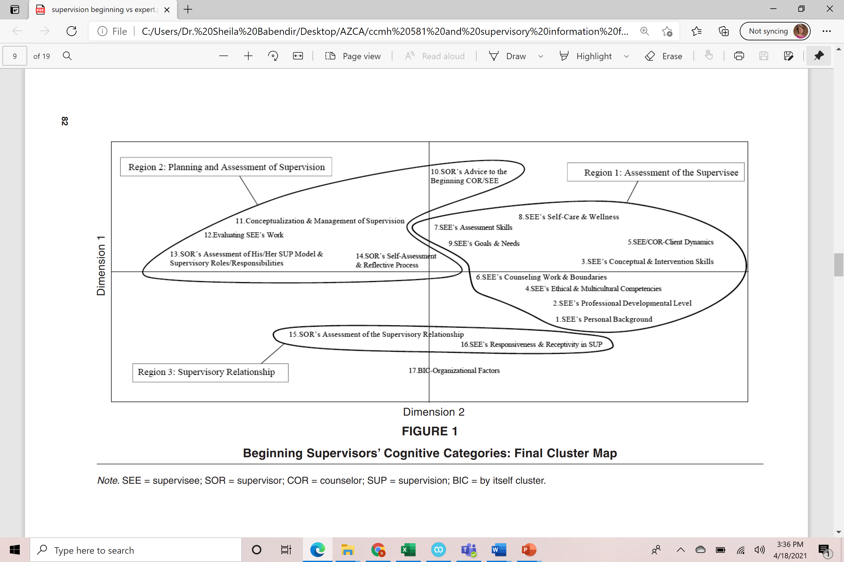

Slide 37
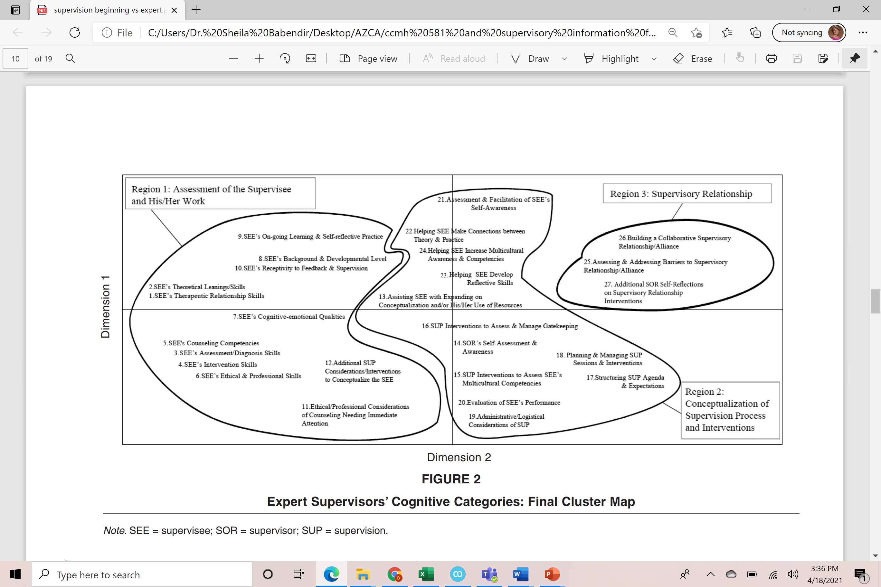

Slide 38
Evaluation
Interns
Colleges will have evaluation forms
Assess skills in core areas: assessment, diagnoses, conceptualization, cultural competence, advocacy, human development, counseling skills and techniques
Associate level counselors
Probably will not have a written evaluation form
Still need to be assessing same skills
Develop your feedback system to evaluate and provide feedback
Notes:
Remember that our role as supervisor is evaluative. We need to have some type of method to evaluate our supervisees.

Slide 39
Feedback
How do you think about feedback….both giving and receiving?
Normalize feedback by discussing it
Structured conversations around feedback, the value and need
Discuss concerns about corrective feedback
Supervisors need to self –reflect on their own comfort with feedback
Supervisors learn about how their supervisees manage feedback
Notes:
feedback is not a commonplace transaction and yet is a central component in clinical supervision as evidenced by the placement of “evaluative” in Bernard and Goodyear’s (2014) definition of the supervisory relationship, then how does a supervisor begin to address potential roadblocks that make it hard for supervisees to accept and use feedback to full advantage in supervision?
Last weekend Lee talked about ways to provide effective feedback and methods or techniques for that.
Today let’s first set the stage for feedback by looking at how to talk about this topic before we actually have to do it.
Start structured conversations focused on the value of feedback, the importance of leaders modeling openness to feedback, and any concerns that members might have about receiving corrective feedback.
preplanning discussions can help normalize feedback,
promote a supervisor’s understanding of self, ---I have to be comfortable with this process of feedback so you, my supervisee can be more comfortable.
and provide a way for the supervisor to learn about the supervisee

Slide 40
Corrective Feedback Instrument
Notes:
In 2006 the Corrective Feedback InstrumentRevised (CFI-R) was introduced (Hulse-Killacky, et al, 2006). The revised instrument consists of 30 items, presented in a 6-point Likert format of response choices: strongly disagree, disagree, slightly disagree, slightly agree, agree, and strongly agree
The feelings factor with 5 items taps emotions associated with corrective feedback.
The evaluative factor includes 5 items that suggest corrective feedback is criticism
The leader factor includes 7 items that refer to the leader’s encouragement of norms that support the exchange of corrective feedback.
The clarifying factor emphasizes the need for clarification so that all parties understand the message being sent
The childhood memories factor with 6 items captures the reality that many reactions to feedback can begin during one’s early years; a function perhaps of culture or family influences that create memories which then may serve as barriers to either giving or receiving feedback.
The written feedback factor includes 4 items that provide information on preferences for written versus spoken feedback.

Slide 41
Feedback take-away
Converse about feedback with supervisees
Supervision is intentional and feedback is a critical part of supervision
Know your own level of comfort, preferences, and barriers to delivering feedback
Lead by example….be open to feedback from your supervisees
Your responsibility is to move supervisees from avoidance of criticism to acceptance of feedback
Feedback is necessary for professional growth and development
Notes:
Conversations on the topic of feedback can take place one-on-one, in small groups, or in movement activities based on responses to selected items.
A conversation on the various ways supervisees interpret and manage feedback helps the supervisor and supervisees learn about each other, develop an understanding of different perspectives, which can eventually lead to increasing self-awareness and the emergence of empathy for different perspectives.
We offer these points to consider: • The practice of supervision is intentional • Feedback is at the heart of supervision • Supervisors need to engage in self-reflection early on about their own preferences, concerns, and barriers to delivering effective feedback • Supervisors have a responsibility to convey early on their openness to feedback as a tool for learning; to lead by example • Supervisors need resources to help them facilitate conversations early on with their supervisees to identify concerns, expectations, and fears about receiving feedback, especially of a corrective nature • The supervisor is always charged with helping supervisees move from avoidance of criticism to an acceptance of feedback; to view feedback as an impetus for professional growth and development

